Slide 1
Power curve interpolation
Power Curve Working Group, Senvion, Hamburg
Daniel Marmander
10th March 2016

Slide 2
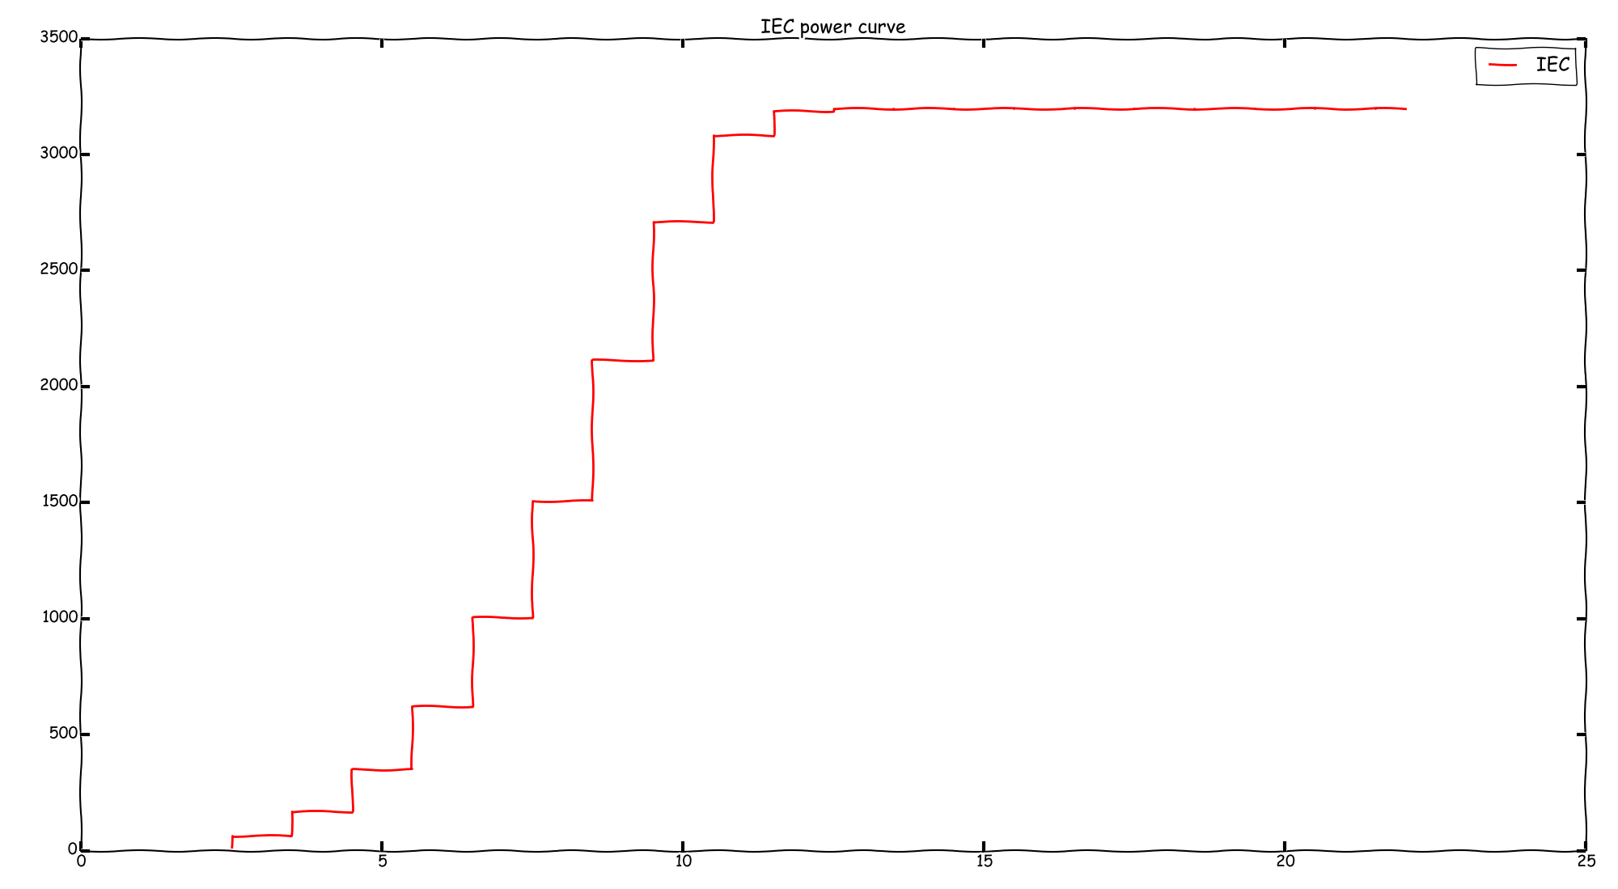

Slide 3
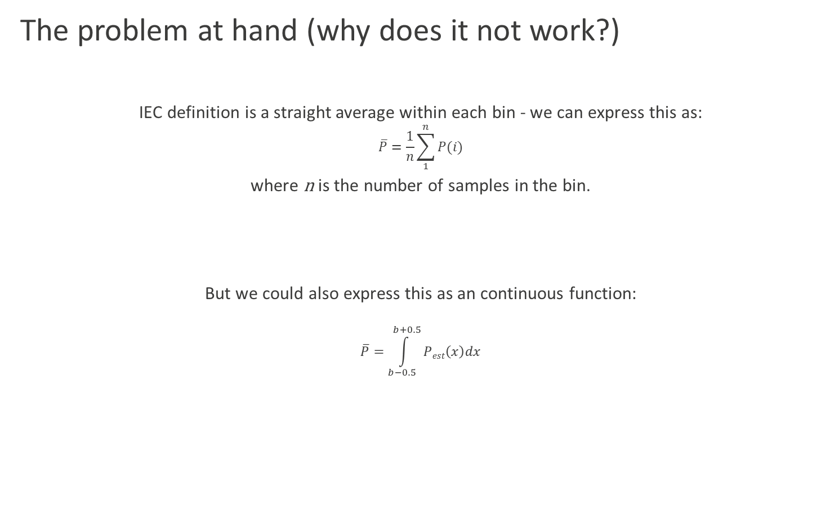
The problem at hand (why does it not work?)
IEC definition is a straight average within each bin - we can express this as:
$$\overline{P}=\frac{1}{n}\sum_{1}^{n}{P(i)}$$
where n is the number of samples in the bin.
But we could also express this as an continuous function:
$$\overline{P}=\int_{b−0.5}^{b+0.5}{Pest\left(x\right)dx}$$

Slide 4
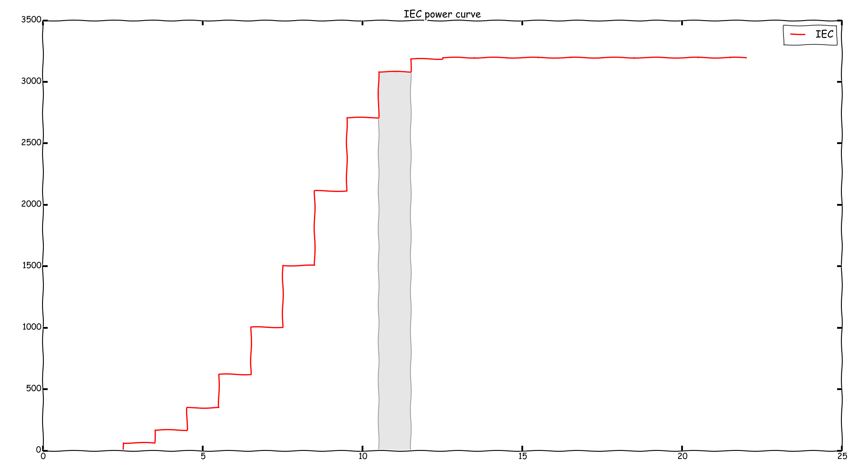

Slide 5
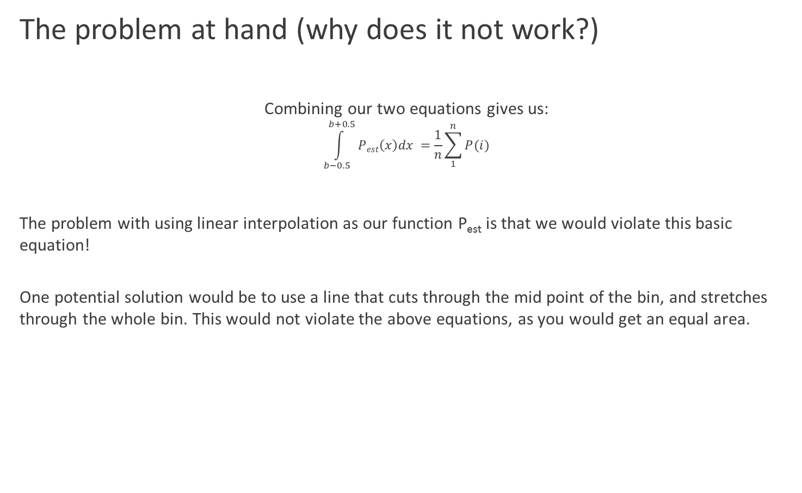
The problem at hand (why does it not work?)
Combining our two equations gives us:
$$\int_{b−0.5}^{b+0.5}{Pest\left(x\right)dx} =\frac{1}{n}\sum_{1}^{n}{P(i)}$$
The problem with using linear interpolation as our function P_{est} is that we would violate this basic equation!
One potential solution would be to use a line that cuts through the mid point of the bin, and stretches through the whole bin. This would not violate the above equations, as you would get an equal area.

Slide 6
In principle, we could ”solve” our problem this way...

Slide 7
But that would potentially produce something like this...
... and that’s just ugly

Slide 8
So what else is needed to fix this?
In order to not get the jumps that we get with the IEC values, our function needs to be continuous. This was our first, and obvious issue.
We have now also realised that we need to preserve the mean, and this means preserving the area under the curve. In other words, we need to preserve the integral of our function.
Lastly, as we don’t expect the real power curve to have distinct ”kinks” (other than at the knee at zero TI), we also want our functions derivative to be continous.

Slide 9
Solution
Set up one system of equations in each bin, stretching from a to b:
F_{b}(x)=IEC-power
f_{b}(a)=f_{b-1}(b)
f_{b}(b)=f_{b+1}(a)
f’_{b}(a)=f’_{b-1}(b)
f’_{b}(b)=f’_{b+1}(a)
Assume that we have F, f, f’ all equals zero at first bin, and F=P_{rated}, f and f’ equals zero at last bin(s).
And then solve this system of equations. Given the number of equations in each bin, it should be a 4:th degree system in each bin.

Slide 10
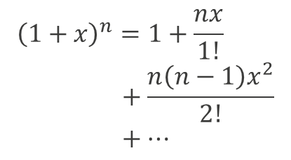
Cool
$${\left(1+x\right)}^{n}=1+\frac{nx}{1!}+\frac{n\left(n−1\right)x^{2}}{2!}+…$$
Not so cool

Slide 11

Cool
$${\left(1+x\right)}^{n}=1+\frac{nx}{1!}+\frac{n\left(n−1\right)x^{2}}{2!}+…$$
Not so cool
Very impractical
Practical

Slide 12
Cool
$${\left(1+x\right)}^{n}=1+\frac{nx}{1!}+\frac{n\left(n−1\right)x^{2}}{2!}+…$$
Not so cool
Linear interpolations
Very impractical
Practical

Slide 13
Alternative solution, that should be good enough
1. Use IEC values as first guess for our instant power curve
2. Use spline interpolation between points in instant power curve
3. Calculate area in each bin
4. If the calculated area does not match the IEC area, then adjust the estimated point, and redo 2. and onwards. Continue until error is low enough. This can be implemented recursively.
Within less than 10 levels of recursion, solution rounds to the same kW.
It seems that 3 degrees is enough for the spline interpolation, which isn’t surprising given the expected shape of a power curve.

Slide 14
Cool
$${\left(1+x\right)}^{n}=1+\frac{nx}{1!}+\frac{n\left(n−1\right)x^{2}}{2!}+…$$
Recursive solution
Not so cool
Linear interpolations
Very impractical
Practical

Slide 15
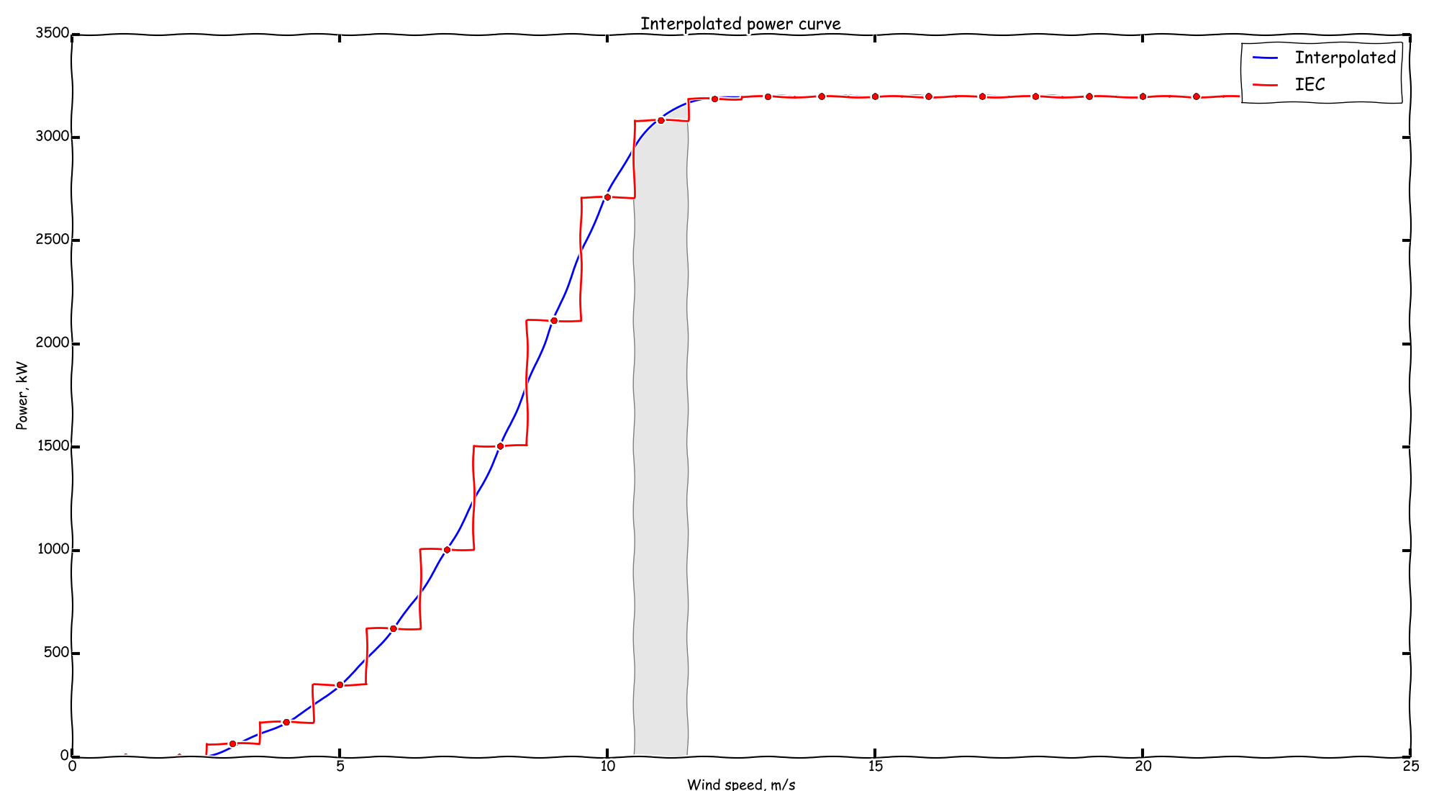

Slide 16
